Slide 1

Duke Undergraduate
Academic Trajectories and
Course Recommender System
Vanessa Tang and Sangseok Lee
SOC728 Final Project
Notes:
Vanessa
Today we are presenting our project on Duke Undergraduate Academic Trajectories and Course Recommender System.

Slide 2
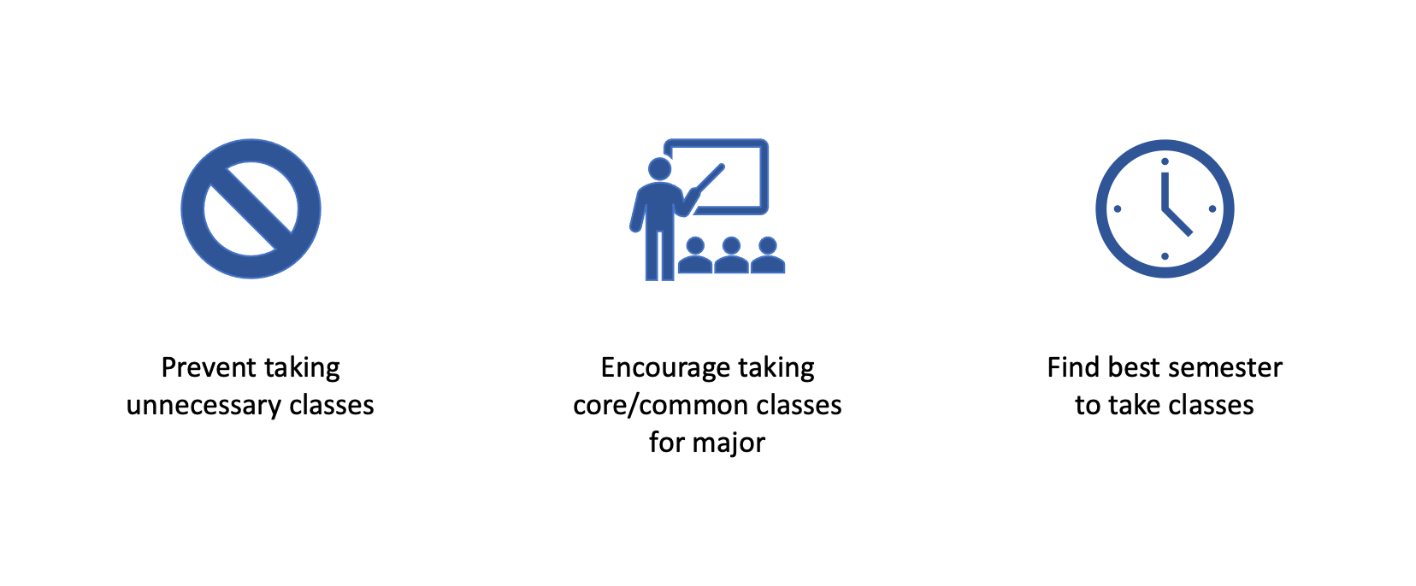
Project Overview
Facilitate course selection
Select and plan classes for major
Duke Registrar Recommender
Notes:
Vanessa
The overall goal of our project is to facilitate course selection for duke undergraduate students. We aim to help students select and plan classes for their desired major. This is important because it ideally can help prevent students from taking unnecessary classes, encourage them to take core classes, in addition to finding the best time to take a certain class. This helps guide students through major selection in addition to class selection and planning throughout their time at Duke.

Slide 3
Data
2013-2020
Calcula- tion ID | Subject // Catalog | Descr | Grade | Class Year | Majors // Minors // Certificates // Secondaries | Enrollment // Graduation Year | College
2760.65 | Linguist 103 | Symbolic Logic | “4.0” | Fourth Year Spring Term | Economics (BS) // Linguistics (AB2) | 2005-2009 | Trinity
Duke Registrar Recommender
Notes:
Vanessa
Our dataset includes degree and enrollment information for all Duke undergraduate students from 2013 to 2020. This consists of de-identified student ID’s, graduation year, majors and minors, in addition to course descriptions, department, grades received, and the semester each course was taken.

Slide 4
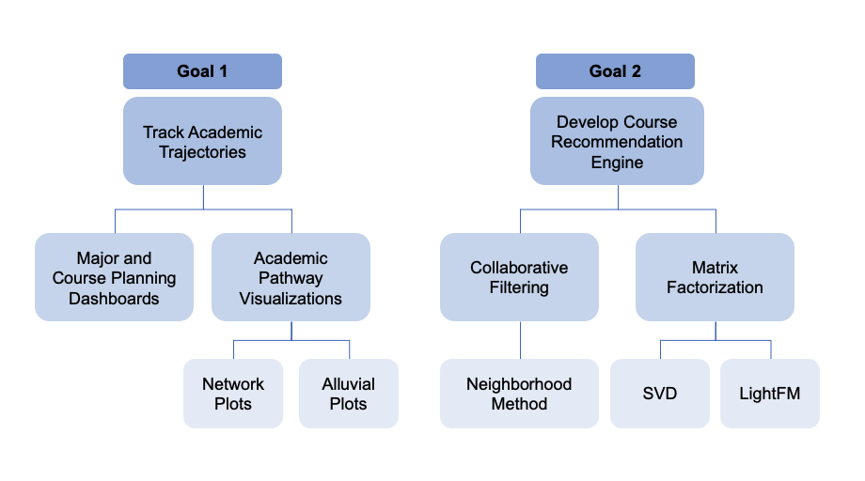
Two Primary Goals
Duke Registrar Recommender
Notes:
Vanessa
Our two primary goals to help facilitate course selection are 1) tracking the academic pathway and 2) developing a course recommendation engine. After spending months trying to develop a recommender engine with little success, we turned to network methods to better understand why our models were not performing well and how we could leverage networks to change the way we approached our project. We focused on 2 majors, Economics and Biomedical Engineering (BME), and compared them to identify key differences that contribute to model performance, course-taking patterns, and academic trajectories.

Slide 5
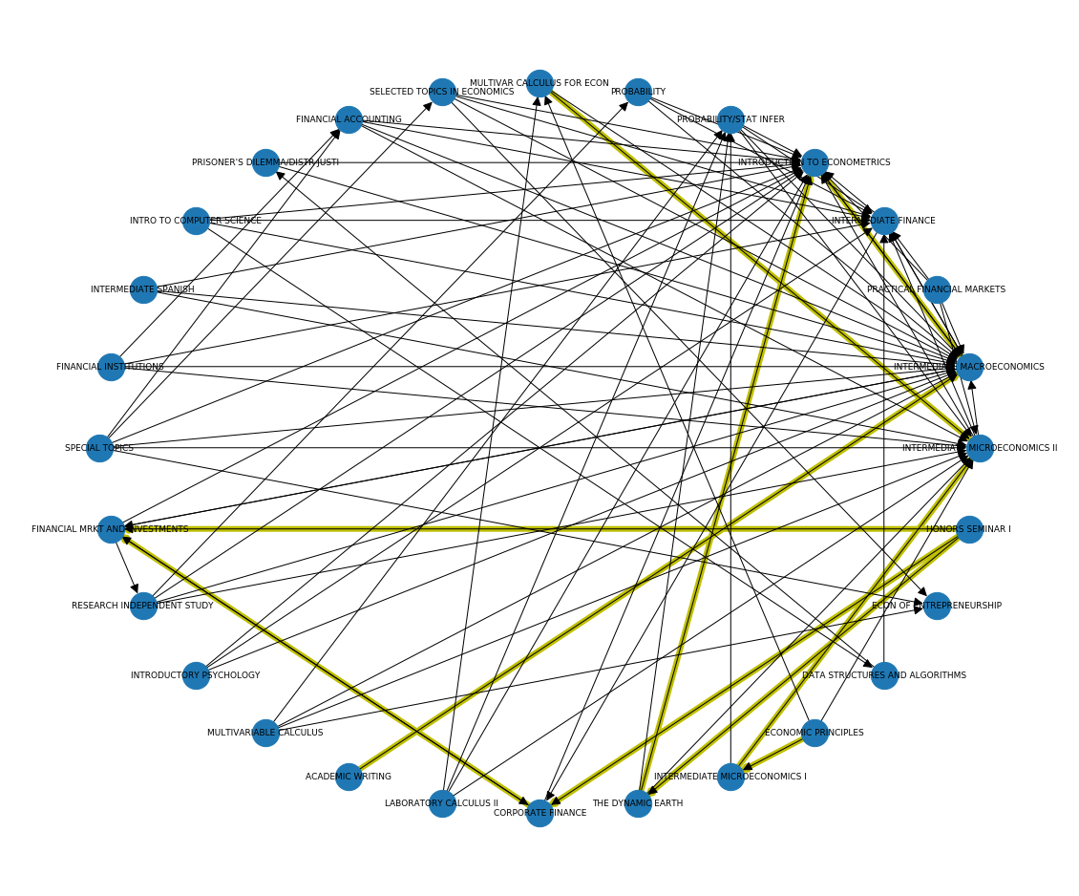
Network Plots
Semester 4 to Semester 5 (Econ)
: more than 30% of students who took one class moved to the other class
Duke Registrar Recommender
Notes:
Vanessa
The first method we used to visualize academic pathways and course progressions was network plots. It essentially shows the transition from the most popular classes in year 1 to those in year 2 for econ majors. Here yellow lines show when more than 30% of students who took one class moved to the other class, which indicates a popular transition from year 1 to year 2. (CLICK) We can also see that Intermediate economics II is a very popular class in year 2.
Using network plots, we can see that there are certain course progressions that are more popular.

Slide 6
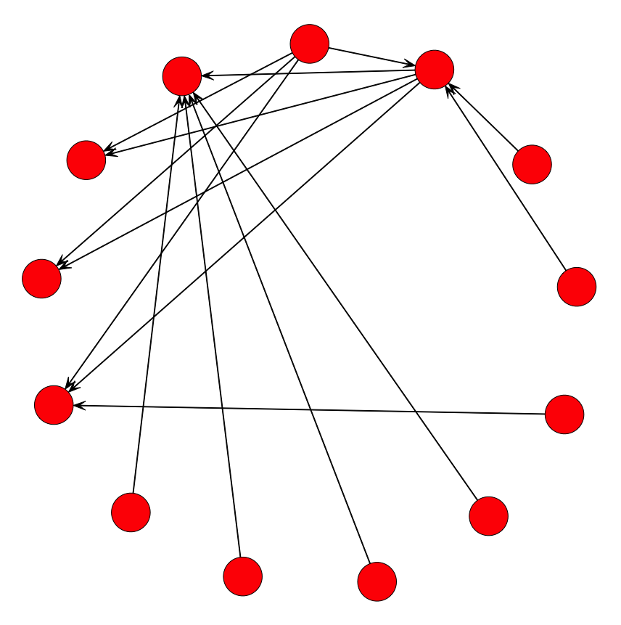
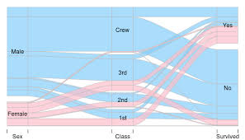
Network Plots: Limitations
Can’t see number of students
Not as clear of a “pathway”
Alluvial Plots: Advantages
Show flow from one state to another
Helps track progression of classes
Duke Registrar Recommender
Notes:
Vanessa
However, network plots are a bit confusing and difficult to read for the general audience. They also don’t show how many students have taken each class. (CLICK) So, we used alluvial plots. Alluvial plots also show flow from one semester to another and highlight pathways in a clearer manner.

Slide 7
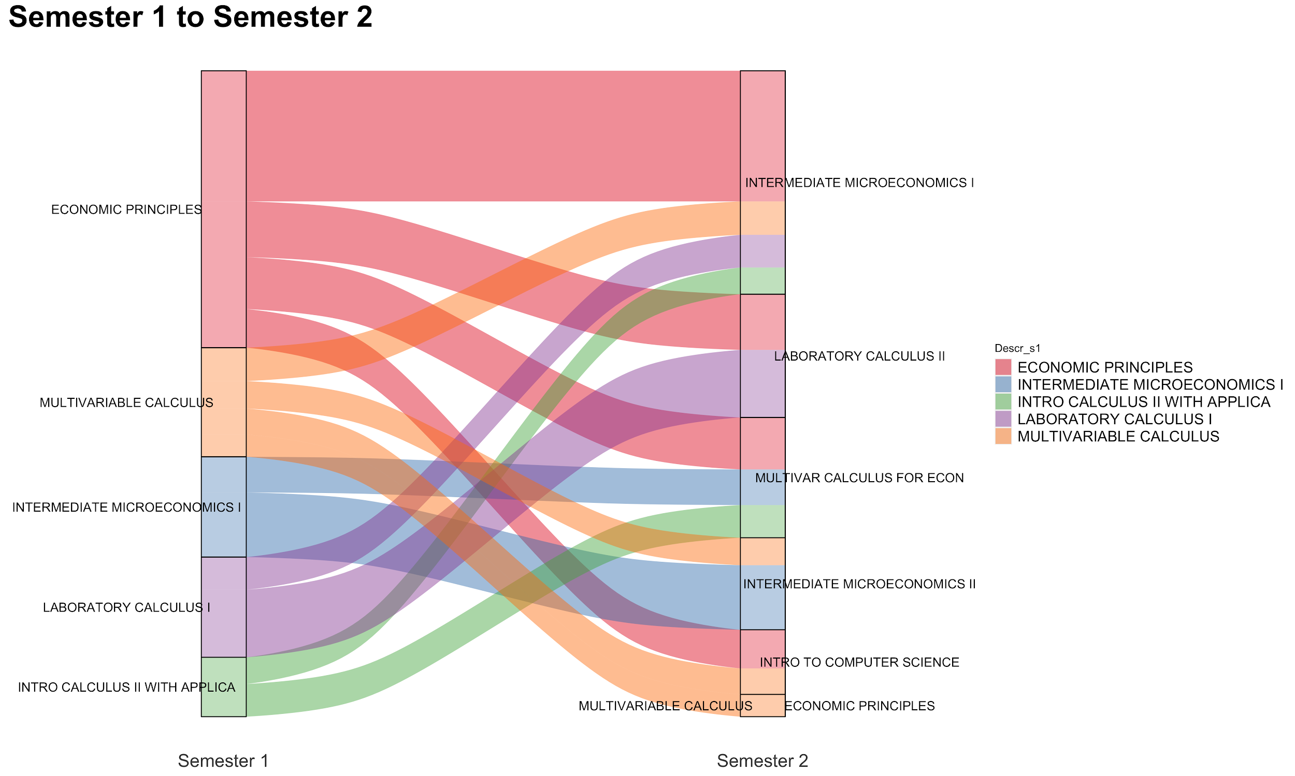
Economics Semester 1 to Semester 2
Notes:
Vanessa
This alluvial plot shows the flow of students from semester 1 to semester 2 for the most popular classes for econ majors. It helps identify pathways and shows popular progressions from one class to the next. In these plots, the width represents the number of students and the colors indicate courses in the first semester.
For example, we can see that many students who take economic principles their first semester take intermediate micro I in their second semester. This indicates that if you’ve already taken economic principles, it would probably be a good idea to consider taking intermediate micro I.

Slide 8
Economics
Semester 2 to 3
Interactive Alluvial Plot Demo
Duke Registrar Recommender
Notes:
Vanessa
Now in this interactive alluvial plot, we can better see trends by hovering over different bars to see counts. However, it would be more helpful to see the pathways across all 8 semesters, which could highlight popular courses to take within a major over time. This could help identify an academic trajectory.

Slide 9
Alluvial Plots: 8 Semesters
Economics and Biomedical Engineering Comparison Demo
Duke Registrar Recommender
Notes:
Vanessa
First looking at the 8 semester alluvial plot for econ, we can see that incorporating more semesters makes these plots significantly more confusing. The terms starting with “other” here group together all classes not listed for that semester, which means that the student took a class not in the top 20 most popular classes for that major. One important parameter is the “threshold.” Because there is such a wide variety of classes that students can take within the same major, we had to drop unpopular combinations. This is represented by the threshold. All combinations of classes for all 8 semesters that had fewer students than the threshold were dropped to make the visualization simpler.
Here, the threshold is 8, which means that all 8-semester long combinations of classes with fewer than 8 students were dropped. This indicates that there is a lot of variability in course-taking patterns for econ students because the threshold is so low.
Conversely, now looking at the 8 semester alluvial plot for biomedical engineering, to get more readable visualization, the threshold can be set to 20, which is much higher than that of econ. If the threshold for econ were set to 20, too many students would be removed from the plot. However, in the case of BME, this shows that more students take the same courses over time and there is probably a clearer course-taking pattern within this major compared to econ.
This variation in threshold between econ and BME indicates some differences in terms of structure and patterns within each major. To dig deeper into this, we used network measures.

Slide 10
Network Measures
Centrality
Quantify interactional tendencies
High centrality: a network with one node capturing the vast majority of ties
Fragile: removing the one central node greatly reduces connectivity
Modularity
Quantify the strength of community structures
High modularity: dense connections within clusters but sparse in different clusters
Duke Registrar Recommender
Notes:
Sangseok
To better understand structure within a major, we used network measures such as centrality and modularity. Centrality help quantify interactional tendences and shows when one node or class within a major capturs the majority of ties.
In order to measure multiple connections among classes, we used modularity. A high modularity suggests dense connections within clusters but sparse connections across different clusters. In the context of our project, majors with high modularity scores have more structure, and there is likely a clearer course-taking pattern within that major.

Slide 11
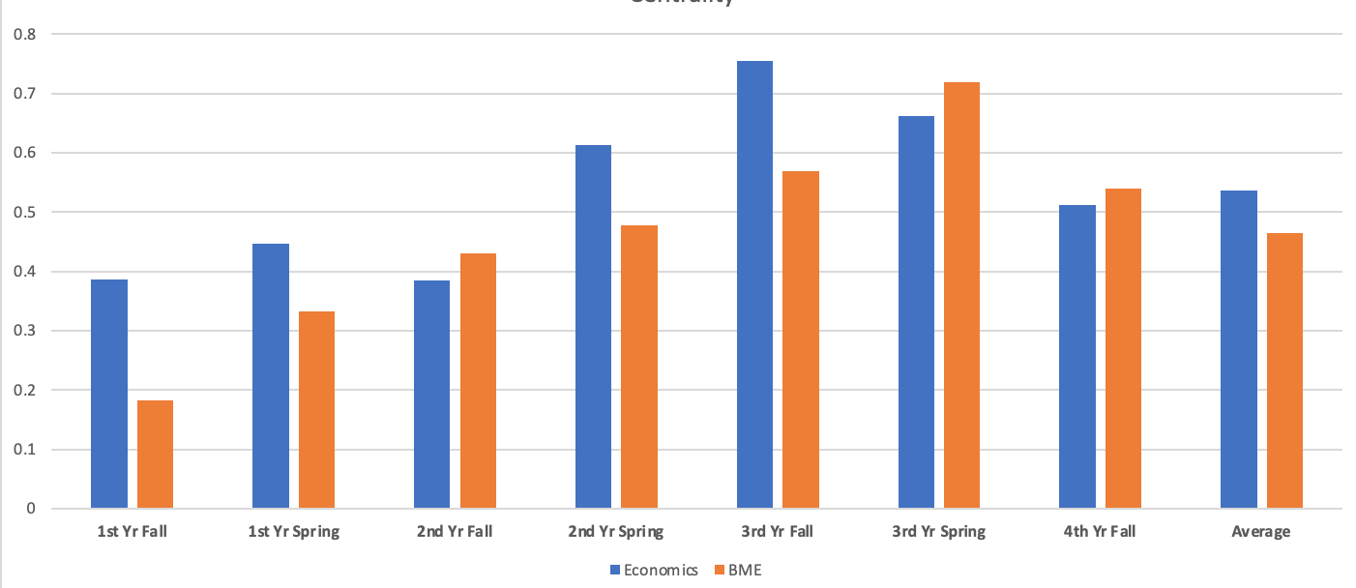
Centrality
 | 1st Yr Fall | 1st Yr Spring | 2nd Yr Fall | 2nd Yr Spring | 3rd Yr Fall | 3rd Yr Spring | 4th Yr Fall
Economics | 0.386 | 0.446 | 0.384 | 0.613 | 0.755 | 0.662 | 0.512
BME | 0.182 | 0.332 | 0.431 | 0.478 | 0.568 | 0.719 | 0.54
Duke Registrar Recommender
Notes:
Sangseok
Economics has higher average centrality than BME, but the centrality changes for each semester. Generally, centrality is higher in the 3rd year. This is potentially because during the third year, students tend to focus on key major requirements or core courses rather than taking a larger variety of courses. Likewise, first and fourth year have relatively lower centrality. During the first year, students are often still figuring out their major, and during the fourth year, students have often completed requirements and take other diverse classes for fun. To further see the difference in centrality between these two majors, we can use the network plots to graph the highest and lowest centrality semesters.

Slide 12

Highest Centrality: 3Y Fall Econ
Notes:
The semester with the highest centrality is 3rd year fall for econ majors. We can see that student still tend to take a wide variety of classes, but intermediate macro, intermediate micro II, and intro to econometrics tend to be very popular courses during this term, as there are several inbound arrows for these nodes.

Slide 13
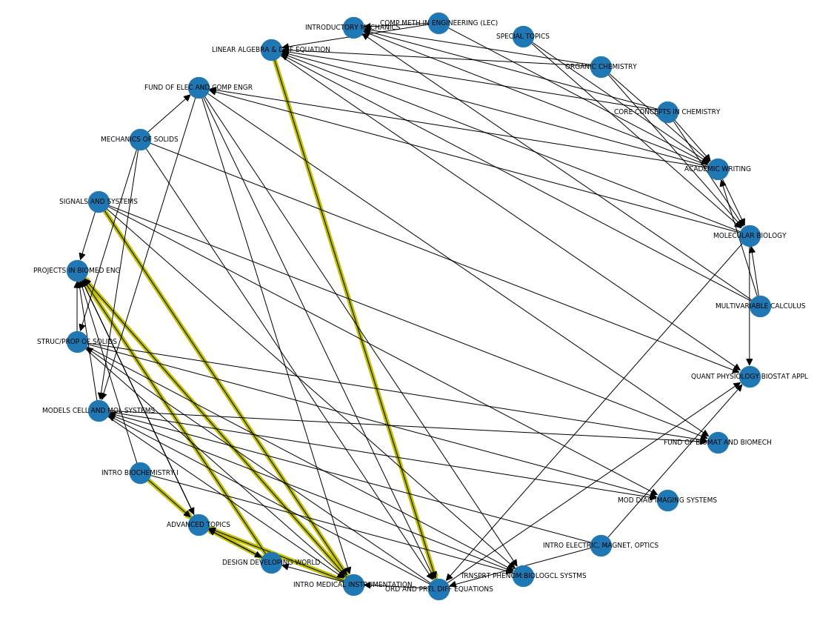
Lowest Centrality: (1Y Fall BME)
Notes:
The semester with the lowest centrality was first year fall term for BME majors. We can see that there doesn’t seem to be a central course that a large proportion of students took. Some classes do tend to be popular, but not noticeably like in the case of econ 3rd year fall.

Slide 14
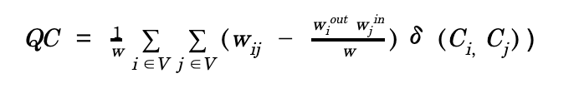
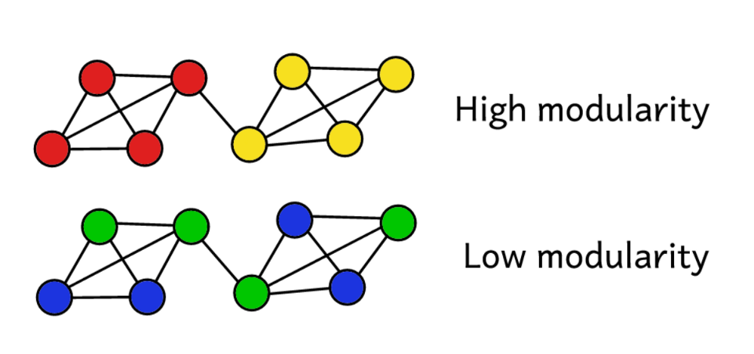
Modularity
Newman, M. E., & Girvan, M. (2004). Finding and evaluating community structure in networks. Physical review E, 69(2), 026113.
Notes:
Next, we can look at modularity.
I think this image here intuitively give you some idea about the general concept of ‘modularity’.
Say we’ve clustered the network into a number of communities or clusters as you will. We use the modularity score to assess the ‘quality’ of this clustering. A higher score will show we’ve split the network into ‘accurate’ communities, whereas a low score suggests our clusters are more random than insightful.

Slide 15
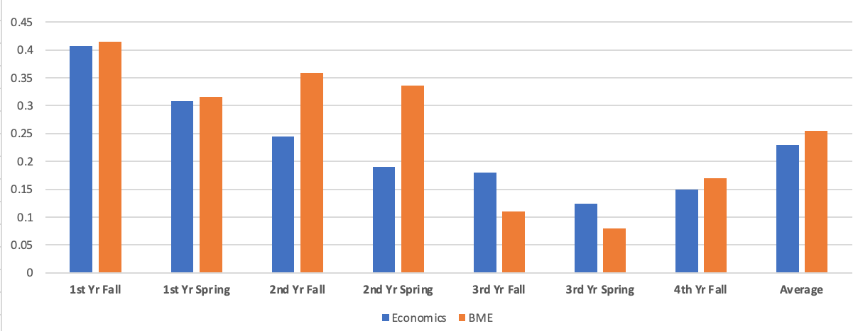
Modularity
 | 1Y Fall | 1Y Spring | 2Y Fall | 2Y Spring | 3Y Fall | 3Y Spring | 4Y Fall
Economics | 0.407 | 0.308 | 0.245 | 0.19 | 0.18 | 0.124 | 0.15
BME | 0.415 | 0.316 | 0.359 | 0.336 | 0.11 | 0.08 | 0.17
Duke Registrar Recommender
Notes:
Here we used Walktrap algorithm to detect communities through a series of short random walks with the idea that the nodes encountered on any given random walk are more likely to be within a community than not.
According to the past literature, walks of length are suggested to use 4 or 5 steps so that we used 5 steps to detect communities .
In contrast to the centrality, Economics has slightly lower modularity than BME in average.
We want to take a look at how clustering was done depending on lowest and highest modularity.

Slide 16
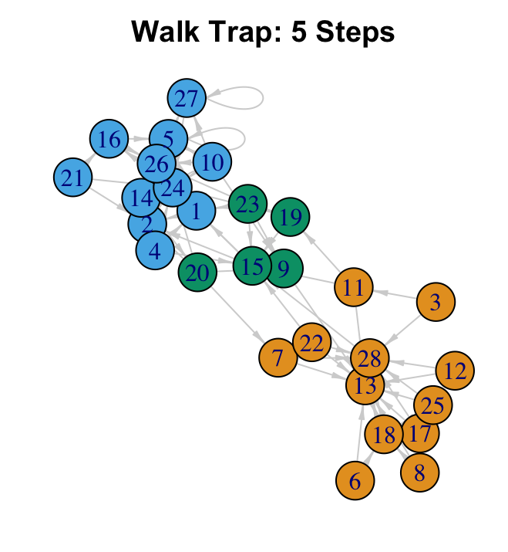
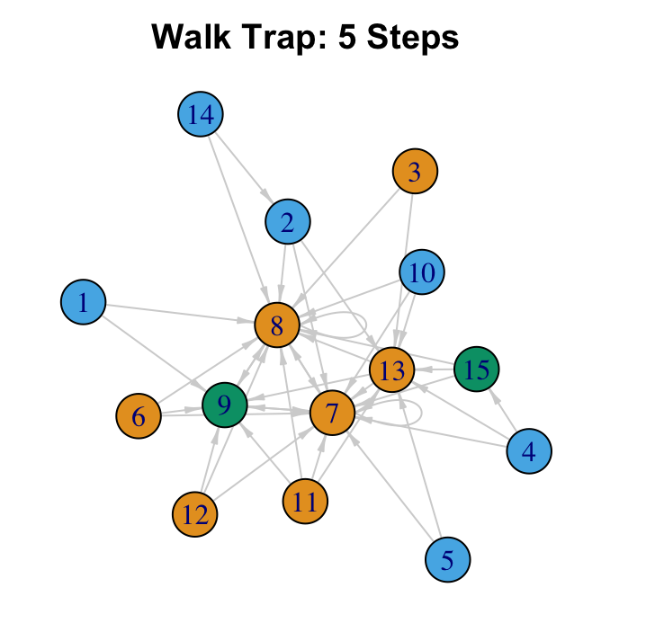
Highest Modularity
(1Y Fall BME)
Lowest Modularity
(3Y Spring BME)
Notes:
As we’ve seen, A higher modularity score shows that we’ve split the network into ‘accurate’ communities, whereas a low score suggests our clusters are more random than insightful. So you see clear examples with the highest modularity and the lowest modularity.

Slide 17
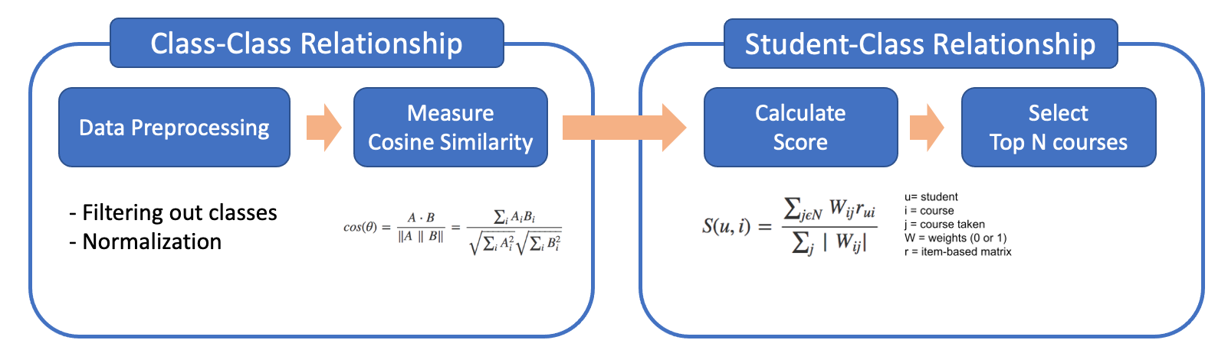
Neighborhood Model: Methods
Duke Registrar Recommender
Notes:
Sangseok
The neighborhood method works by first measuring the class-class relationship. This requires preprocessing that includes filtering out classes taken less than N students and normalizing student’s class selection. Then cosine similarity between classes is calculated using the equation below. Given the class to class similarity matrix, (CLICK) the next step is to find the student to class relationship. To do so, we calculate each student's similarities by calculating a score for each class per student based on the binary weights and the item-based matrix. Finally, recommendations can be generated by taking the top n courses with the highest score.

Slide 18
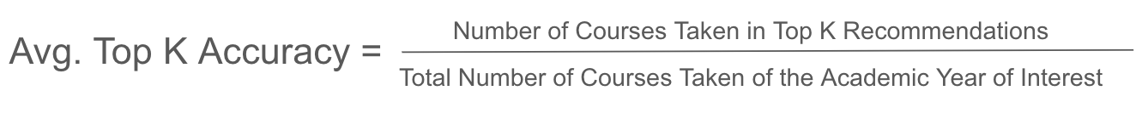
Neighborhood Model: Results
(k = 10) | 2Y Fall | 2Y Spring | 3Y Fall | 3Y Spring | 4Y Fall | 4Y Spring | Average
Accuracy | 60.8% | 49.7% | 51.1% | 50.7% | 38.6% | 33.8% | 47.6%
Duke Registrar Recommender
Notes:
Sangseok
We define prediction accuracy as the number of courses actually taken in the top K recommendations divided by the total number of courses taken during the selected semester. Because students usually only take 4 courses per term, we expect this accuracy to be low, as the model tries to accurately capture just these four courses.
Using our accuracy metric, we can evaluate the performance of the neighborhood method. Note that we do not use this model for first year students because these students have taken little to no classes as you can imagine. In the field of recommender systems, this is known as the cold start problem, where models struggle with recommendations for new users due to the lack of data.
Now looking at our model results for just Econ students, we can see that the model performs quite well, reaching almost 61% in the second year fall term. This indicates that the model can correctly predict almost half of the classes that the student ended up taking.

Slide 19
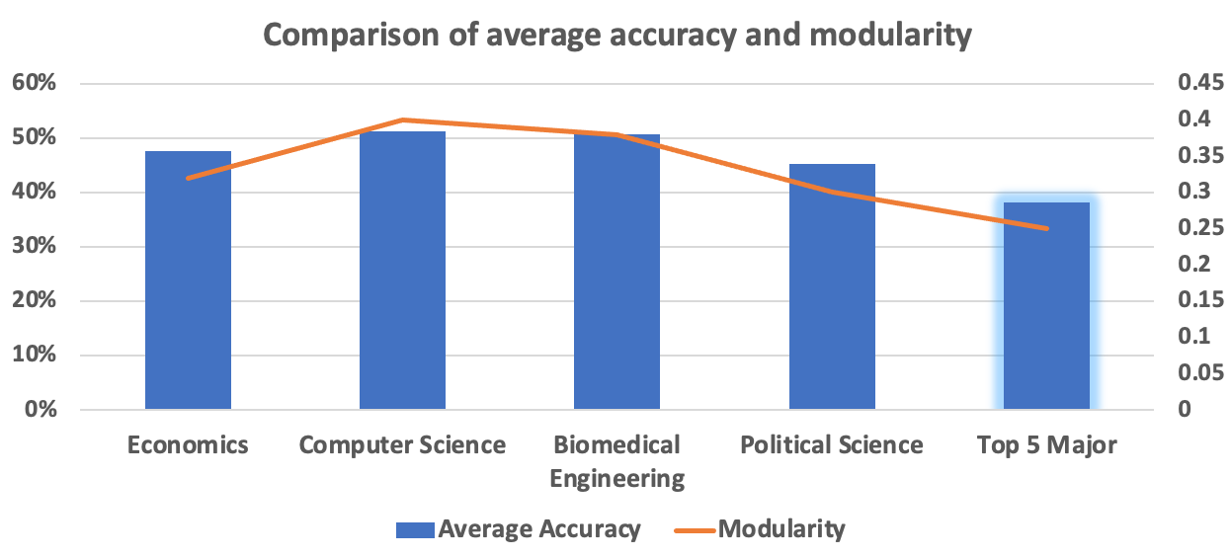
Comparison of Accuracy and Modularity
Average Accuracy
Modularity
Duke Registrar Recommender
Notes:
Sangseok
To see the relationship between prediction accuracy and modularity across different majors, we plot accuracy in blue and modularity in orange for 4 majors and a group of the top 5 majors. We can see that modularity and accuracy follow very similar trends where majors with high modularity also have high accuracy. Among the selected majors here, computer science and biomedical engineering majors are relatively more structured with higher accuracy and modularity compared to others.
This also confirms our observations from the 8 semester alluvial plots, where the pathway was clearer for BME students in comparison to econ students. BME has higher modularity and accuracy while econ has lower modularity and accuracy. This indicates that the course-taking pattern is more structured and therefore more predictable within the BME major in comparison to Econ.

Slide 20
Conclusion
Academic trajectory visualizations
Network plots
Alluvial plots
Economics vs. BME
Centrality
Modularity
Neighborhood model performance
Duke Registrar Recommender
Notes:
In conclusion, we used network and alluvial plots to track academic pathways and course progressions over time. In creating alluvial plots for different majors, we found that some majors had a clearer course-taking pattern than others. To help quantify this, we compared economics and biomedical engineering majors using network measures such as centrality and modularity to help show course-taking patterns, structure, and central courses for certain semesters for each major.

Slide 21

Thank you!
Vanessa Tang, Sangseok Lee, Yiran Chen
Duke Registrar Recommender
Notes:
Thank you for listening!

Slide 22
Appendix
Notes:
1-4: Becky (Intro)
5-8: Vanessa (Dashboards)
9-11: Sangseok (Network Plots)
12-14: Vanessa (Alluvial Plots)
15-16: Becky (Recommender System Intro/Comparison)
17-20: Sangseok (Neighborhood)
21-23: Becky (Conclusion)

Slide 23
Academic Pathway: Major Selection and Course Planning
If a student plans to take one class or a set of classes,
What major are they likely to graduate with?
What classes are important to that major?
When are these classes commonly taken?
Duke Registrar Recommender
Notes:
Vanessa
Imagine its your freshman fall term. You’re enrolled in four classes now, but don’t know what to take next semester. What majors should you consider? What classes should you take? When should you take those classes for your interested major?

Slide 24
Course and Major Selection Dashboard Demo
Notes:
Vanessa

Slide 25
Course Dashboard Feedback
Pros
Synthesize lots of information
Easy to understand and use
Thorough: allows for major and course searching
Suggestions
Add more course data
Add professor ratings and course evaluations
Search by course catalog number
Duke Registrar Recommender
Notes:
Vanessa
After interviewing academic advisors and undergraduate students, we found that they liked that the dashboards synthesized a lot of information in an understandable, user-friendly way. Furthermore, the dashboards are very thorough as it allows for searching for both classes and majors and enables course load planning.
However, some suggestions for improvement included the addition of more course data, such as course locations, times, and prerequisites, as well as course and professor evaluations. Furthermore, students recommended also searching by catalog number.
Overall, the feedback on our dashboards was overwhelmingly positive and emphasizes the effectiveness in providing useful information in a very simple and understandable way to help guide the course and major selection process.

Slide 26
Challenges
No information on:
Graduation/Major requirements
Course: prerequisites, availability, ratings, professors
High variability
Students don’t have to declare until beginning of junior year
Switching majors
Time: course order matters
Duke Registrar Recommender
Notes:
Given the data, one major challenge is that we do not have graduation and major requirement information, course prerequisite information, or course ratings, which are all valuable references for students’ course selection process. Another challenge is that there is an immense amount of variation in course-taking patterns, even amongst students of the same major. This is due to the fact that students can take a wide variety of classes to satisfy a major, they don’t have to declare until junior year, and they can switch majors throughout their time at Duke. Furthermore, course order matters, and factoring this temporal aspect into a recommender system is challenging.

Slide 27
Data: Summary Statistics
Final dataset for the 2013 to 2020 segment
325,107 records
13,513 students
4,224 unique classes
141 different primary majors
Duke Registrar Recommender
Notes:
After cleaning and restructuring the data so that each row represented one class, the final dataset for the 2013 to 2020 segment had 325 thousand observations with over 13 thousand students and over 4 thousand unique classes. Among this group, there are 141 different primary majors.

Slide 28

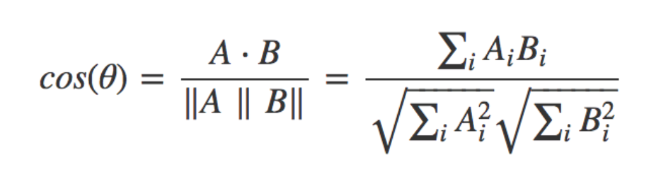
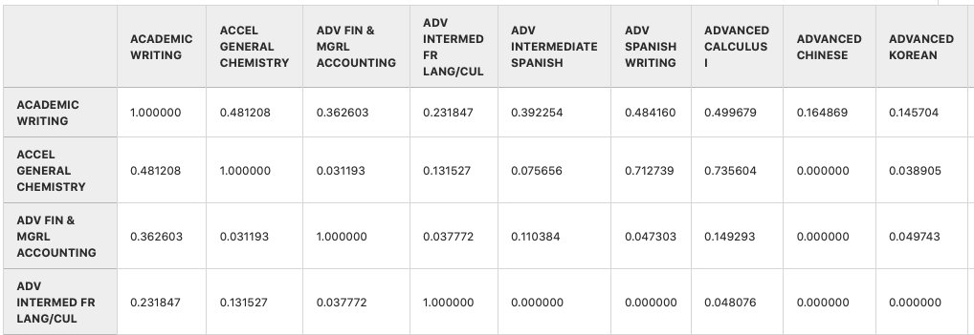
Neighborhood Methods
Duke Registrar Recommender
Notes:
Our collaborative filtering model combines both item and user based methods by creating a “neighborhood” of similar courses. Given our problem, item-based models depend on courses, and user-based models depend on students.
First, we calculate the cosine similarity between courses to construct a new item by item matrix, as shown.
[easier explanation]
you chose one class, let’s say Machine Learning course, and you want to know what classes are the nearest, which means what other classes are closely related to Machine Learning course based on cosine similarity. So using cosine similarity, we now have a list of similar classes with data to decision. This is called item-based method.
However, you want to know what classes other students take, in other words, you wonder other students that have similar pattern just like you. This is called user-based method. So using item-based method with multiple classes, you sort classes by highest similarities.

Slide 29
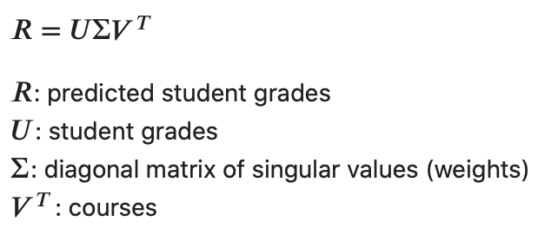
SVD
Singular Value Decomposition (SVD)
Creating training and testing datasets
4 yrs
Train Dataset
Train students
Yrs 1 and 2
Test students
Yrs 3 and 4
Test Dataset
Duke Registrar Recommender
Notes:
Other than neighborhood methods, another popular method commonly used in recommender systems is matrix factorization. One popular algorithm for matrix factorization is called singular value decomposition, where student grades can be predicted by multiplying U (the student grade matrix), sigma (the diagonal matrix of weights), and V transposed (all the courses).
Listening to feedback from others, we decided to try a different train test split method. We first split the students in 80% training students and 20% test students. For the training students, all 4 years of data were added to the training dataset. For the test students, years 1 and 2 were added to the training dataset and years 3 and 4 are left out and considered the test dataset. Thus, the matrix that is fed into SVD contains 4 years of data for 80% of the students and 2 years of data for 20% of the students. We can then test SVD performance on years 3 and 4 from the test students.
Go into factors and find earlier classes that have large weights for later classes
Find earlier classes that determine success/failure in later classes
Look at students who didnt do well
Logistic regression to predict prob of certain classes
Clustering
Decision trees

Slide 30
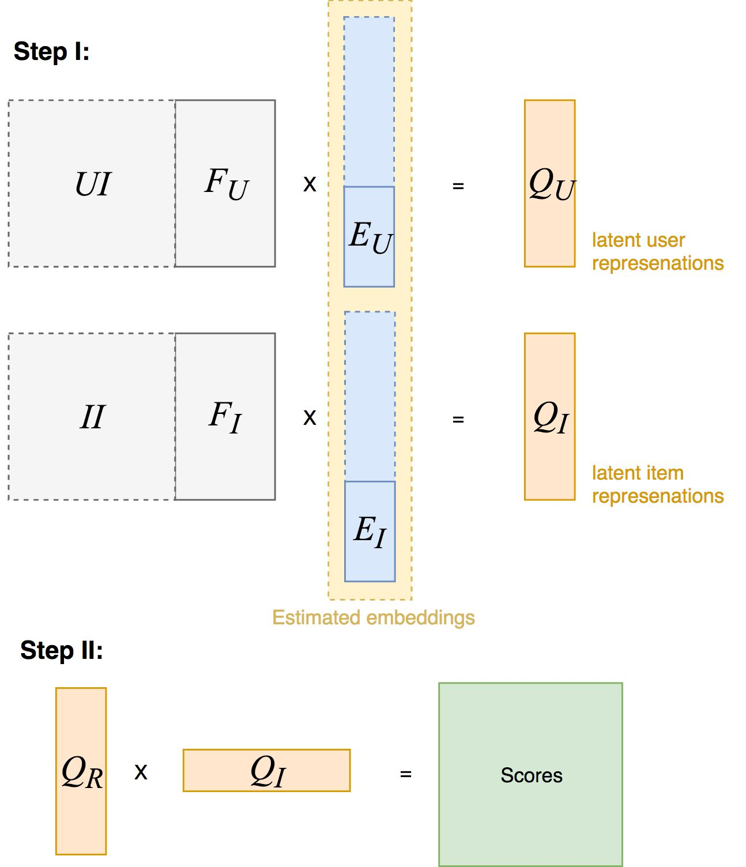
LightFM
User feature:
major, minor
Item feature:
subject, class_year (both multi-hot representation)
Each feature encoded as latent vectors of specified size

Slide 31


Future Work
Add more data to dashboards: professor, time, location, syllabus, description
Effective representations
Evaluation metrics
Accuracy, Relevance, Diversity
Duke Registrar Recommender
Notes:
In terms of future works, we would like to integrate more data to the existing dashboard, such as course time, location, syllabus, descriptions, and professors. To improve the performance as well as the practical applications of the recommendation model, we can investigate other representations of courses using advanced techniques, such as word embeddings, to identify cluster structures and similar classes across different domains. This could potentially provide new information that could improve model performance. For better evaluation, other metrics such as relevance and diversity metrics could be further added to better gauge the strengths and weaknesses in different models.

Slide 32
Centrality | 1st Yr Fall | 1st Yr Spring | 2nd Yr Fall | 2nd Yr Spring | 3rd Yr Fall | 3rd Yr Spring | 4th Yr Fall
Economics | 0.386 | 0.446 | 0.384 | 0.613 | 0.755 | 0.662 | 0.512
BME | 0.182 | 0.332 | 0.431 | 0.478 | 0.568 | 0.719 | 0.54
Modularity | 1Y Fall | 1Y Spring | 2Y Fall | 2Y Spring | 3Y Fall | 3Y Spring | 4Y Fall
Economics | 0.407 | 0.308 | 0.245 | 0.19 | 0.18 | 0.124 | 0.15
BME | 0.415 | 0.316 | 0.359 | 0.336 | 0.11 | 0.08 | 0.17
Duke Registrar Recommender
Notes:
Sangseok
Economics has higher average centrality than BME, but the centrality changes for each semester. Generally, centrality is higher in the 3rd year. This is potentially because during the third year, students tend to focus on key major requirements or core courses rather than taking a larger variety of courses. Likewise, first and fourth year have relatively lower centrality. During the first year, students are often still figuring out their major, and during the fourth year, students have often completed requirements and take other diverse classes for fun. To further see the difference in centrality between these two majors, we can use the network plots to graph the highest and lowest centrality semesters.

